Slide 2
Team Expandables (Team 4)
Amit Singh - (Mentor)
Tripuresh Tripathi
Shweta Kumari
Barkha Singh
Tabish Sharma
Yathartha Sundhan

Slide 3

HSBC Banking AI
Voice Assistance (Multi-Lingual)
Get instant help with your HSBC banking needs in English, Hindi, or Bengali - No matter from where you are.

Slide 4
Agenda
Problem Statement​
Technology Stack
Reference Architecture
Implementation
Capabilities & Limitations​
Challenges & Learnings​
Application Screenshots

Slide 5
Problem Statement
1
We noticed that it's not easy for everyone to get quick help with their banking questions,
especially if they speak different languages.
2
This bot also saves a lot of time. Instead of searching through the FAQ page to find your answer,
you can just ask your question and get a response quickly.
It's a more efficient way to get help and saves your precious time.
3
Imagine if you could just talk to your bank and get answers in English, Hindi, or Bengali,
no matter from where you are.

Slide 6
Technology Stack
First, we needed a way for the computer to understand what people are saying.
We used Google's speech-to-text
1
2
Then, we needed a way to find the answers to people's questions in our database.
We called this database Chroma DB.
3
We also needed a way to talk back to people, so we used Google's text-to-speech.

Slide 7



Reference Architecture
Speech Recognition
Language Support
Query Resolving
Seamless translation between English, Hindi, and Bengali.
Understand the Question given by user and provide the information based on the given database on HSBC given website.
Our AI bot technology can understand your voice commands in multiple languages.

Slide 8
Implementation Details
1
Language Selection
2
Speech Recognition
Allows customers to choose their preferred language
Understands customer queries
3
Chroma DB Integration
4
Text-to-Speech
Quickly retrieves answers from the knowledge base
Provides responses in the selected language

Slide 9
Capabilities and Limitations
Capabilities
Limitations
Understand English, Hindi, and Bengali
May not understand strong accents
Quickly find answers in Chroma DB
Dependent on information in Chroma DB

Slide 10


Challenges and Learnings
Integration Challenges
Language Handling
Coordinating different technologies to work seamlessly
Ensuring accurate speech recognition and text-to-speech
User Interaction
Understanding customer expectations for a voice assistant

Slide 11
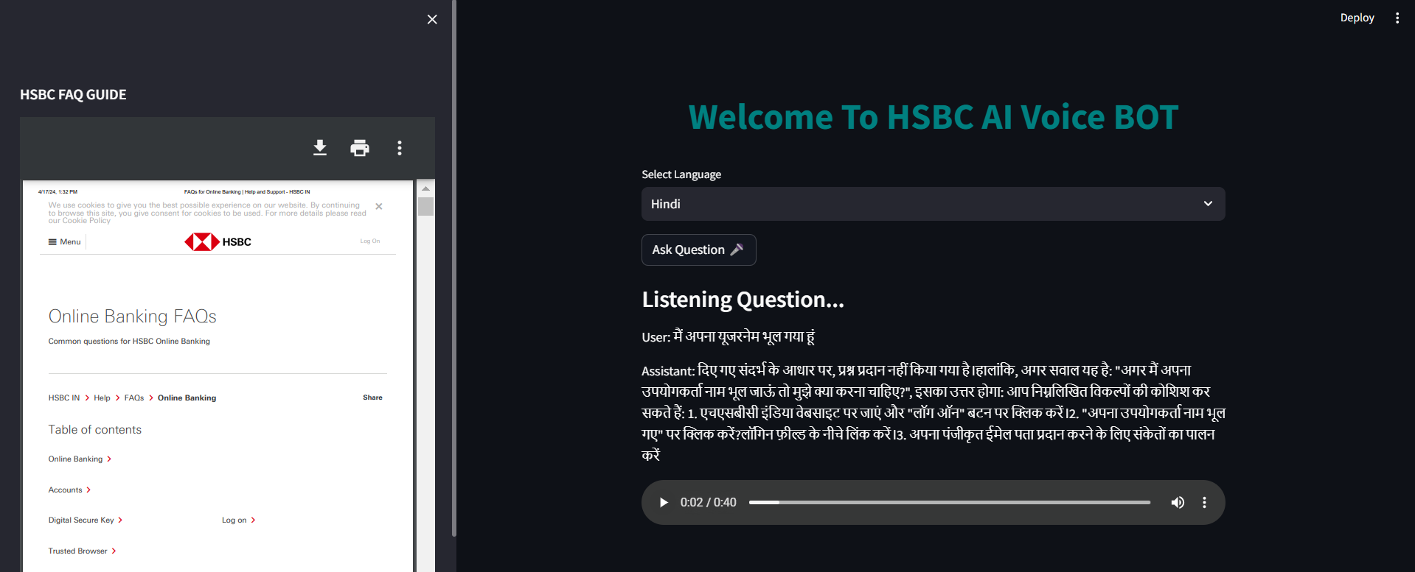
Screenshot of Application

Slide 12


